Slide 1
OVERVIEW OF OM TRAINING

Slide 2
OVERVIEW OF OM TRAINING – WHAT I LEARNT
Clarity of terms (eg: experiment, simulation, scenario, archetype etc)
From XML to OpenMalariaUtilities
Running simple experiments locally and on sciCORE
Building a workflow for running simulations and processing
From archetypes to country-specific experiments

Slide 3
Background – What do we intend to do?
In the current OM calibration, the EIR bears all the uncertainty
This PhD attempts to disentangle this uncertainty by identifying and quantifying uncertainty of intervention and geographic parameters and assessing their impact on intervention scenario evaluation.
I thought that you are interested mainly to identify sources of uncertainties and quantify uncertainties of model parameters, leading to more accurate estimations of the uncertainty of model outputs - Monica
Notes:
This PhD focuses on quantifying the uncertainty in agent-based model outputs, particularly in the context of malaria intervention modeling. The primary objective is to assess how parameter uncertainty affects the robustness of model outputs and resulting conclusions made for future planning of interventions at the sub-national level

Slide 4
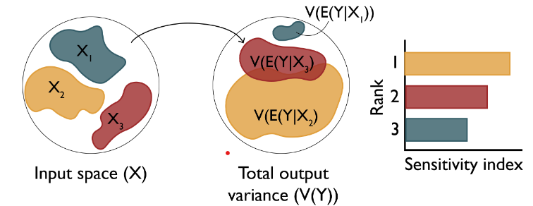
Objective 1 - Variance-based approach (eg. Sobol indices)

Slide 5
OVERVIEW OF OM TRAINING – LINK TO MY PhD
S

Slide 6
Uncertainty Quantification of Agent-Based Models with Application to Malaria Intervention Modeling Zenabu Suboi

Slide 7
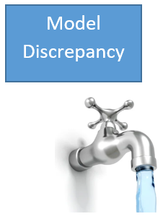
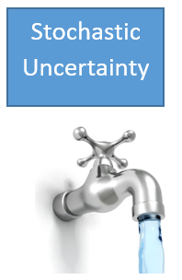
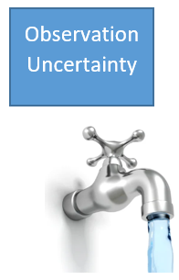
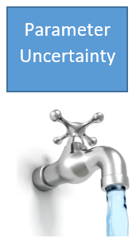
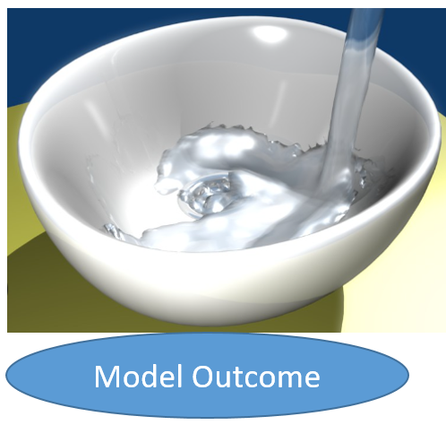
Background

Slide 8
Introduction
All of this parameter uncertainty is currently borne by the EIR in OM
Meanwhile, other parameters also contribute to this uncertainty (eg: itn coverage (effective))
Disentangle the uncertainty by identifying other drivers in addition to the EIR and estimating them

Slide 9
Background: Sources of Uncertainty in Intervention Modeling
ITN Effective Coverage
SMC Coverage
geostatistical effective intervention coverage
Use of RCTs for

Slide 10
Introduction
This PhD attempts to quantify uncertainty of agent-based models with application to malaria intervention modeling.
It aims to understand how much uncertainty we can afford to ensure robust conclusions are made for future planning of interventions at the sub-national level.

Slide 11
Introduction
It seeks to consider and account for other sources of uncertainty in the OpenMalaria Ghana model, apart from the entomological inoculation rate (EIR) and
assess the impact this would have on intervention scenario evaluation at the sub-national level.

Slide 12
Objectives - 1
Zoom into the parameters of the model as they contribute differently to the uncertainty
Identify key drivers of this source of uncertainty
detect and rank those parameters which need to be better measured in order to reduce the output variance
With focus on geographic specificity
Sensitivity analysis

Slide 13
Objectives - 2
Use a sampling-based approach to «find the true values (infer)» of these parameters
To reduce their uncertainty
results in a reduction in the uncertainty in the model outcome
Calibration

Slide 14
Objectives - 1
Use sensitivity package in R to calculate sensitivity indices
Rank parameters in order of their importance
Sensitivity analysis

Slide 15
Objectives - 3
Improve model calibration with uncertainty to enhance accuracy and reliability for malaria intervention modeling in Ghana.
Refine subnational-tailoring modeling scenarios for Ghana
Develop prioritisation criteria for combinations of interventions at the district level.
focus will be placed on ITNs?, SMC? and vaccines? in terms of uncertainty quantification and propagation.

Slide 16
Where do I need help now?
OM is required everywhere
Obj 1: Any existing code on performing sensitivity analysis in OM from the group? –how to implement in OM
Obj 2: How to implement sampling methods in OM
Obj 3: Assistance from the OM training team to build the full simulation experiment for Ghana at the district level

